Slide 1
Assembling an IoT Device
Presented by
Eng. NIYITEGEKA Janvier
RP/IPRC TUMBA

Slide 2
What is an IoT Device?
A "Thing" can be any object that has a unique identifier and which can send/receive data over a network (e.g., smart phone, smartTV, computer, refrigerator, car, etc.).
• IoT device is a thing that can be connected to the Internet and send information about themselves or about their surroundings.

Slide 3
Examples of an IoT device
A home automation device that allows remotely monitoring the status of appliances and controlling the appliances.
An industrial machine which sends information abouts its operation and health monitoring data to a server.
A car which sends information about its location to a cloud-based service.
A wireless-enabled wearable device that measures data about a person such as the number of steps walked and sends the data to a cloud-based service.

Slide 4
IoT Device Requirements
Sensing Capability
Computation/Processing capability
Communication capability
Storage capability

Slide 5
Components of an IoT Device
(i) I/ O interfaces for sensors,
(ii) interfaces for network/internet connectivity,
(iii) memory and storage interfaces
(iv) Processing device
(v) audio/ video interfaces.

Slide 6
Device Platforms
Pycom Lopy
Raspberry Pi
microcontroller platforms:
Arduino Series
NodeMCU

Slide 7
Hardware Interfaces
Universal Serial Bus (USB)
General-purpose input/output pins (GPIO)
GPIO pins can be digital or analog signals, and digital pins have only two states: HIGH or LOW.
Digital GPIO can support Pulse Width Modulation (PWM).

Slide 8
Hardware Interfaces
Inter-Integrated Circuit (I2C): serial bus uses a protocol that enables multiple modules to be assigned a discrete address on the bus.
Universal Asynchronous Receiver/Transmitter (UART) devices translate data between serial and parallel forms at the point where the data is acted on by the processor
Serial Peripheral Interface (SPI.) bus devices employ master-slave architecture, with a single master and full-duplex communication.

Slide 9
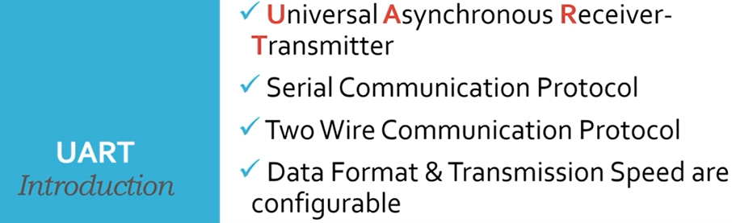

Slide 10
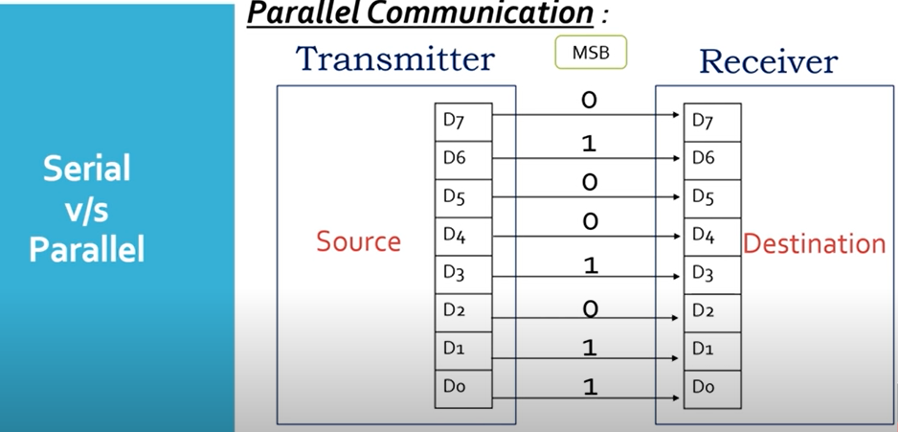

Slide 11
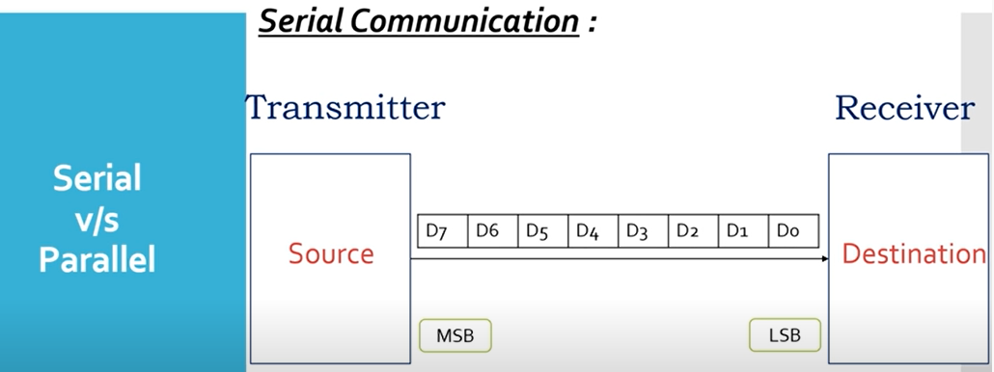

Slide 12
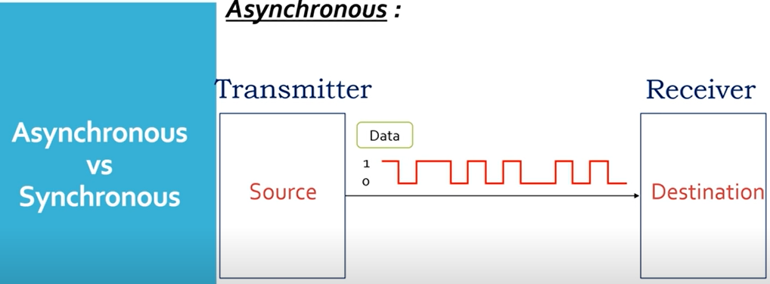

Slide 13
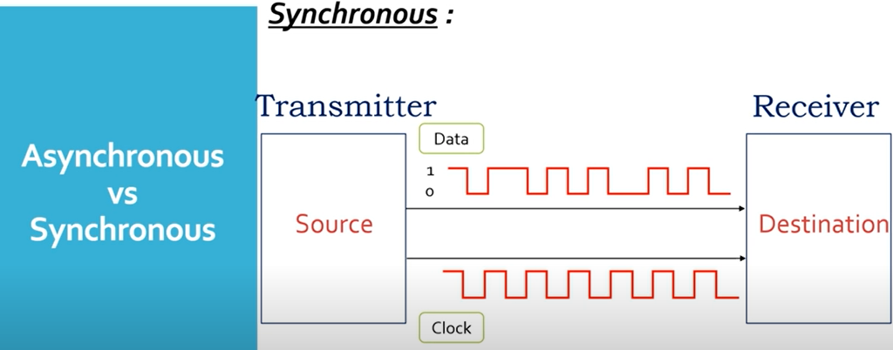

Slide 14
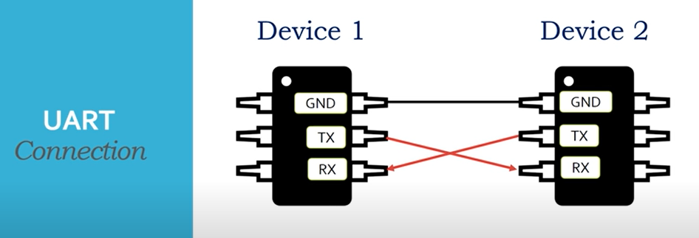

Slide 15
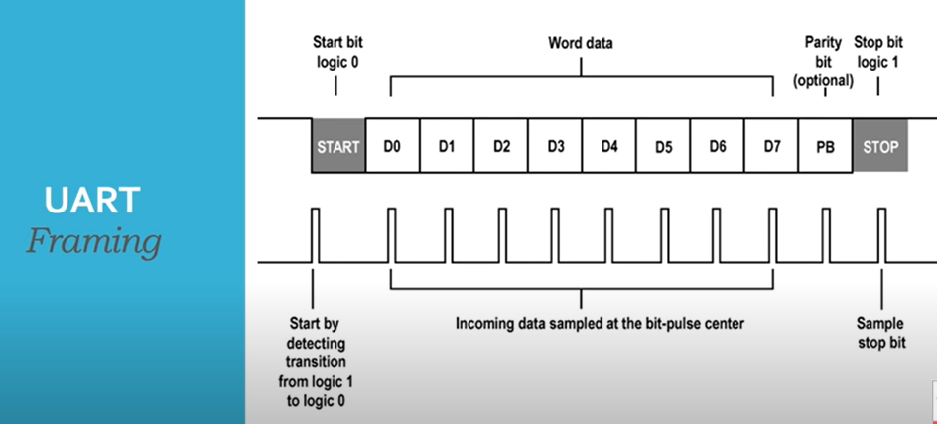

Slide 16
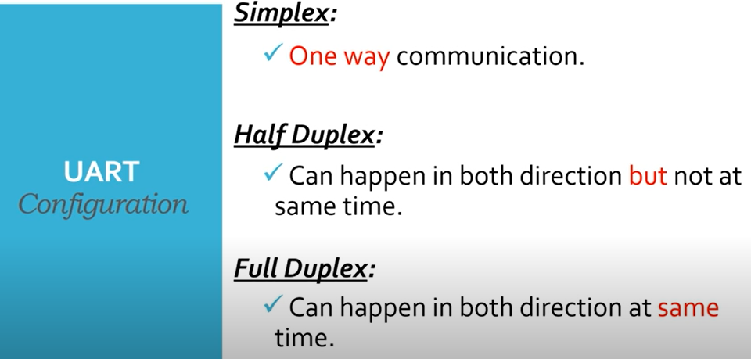

Slide 17
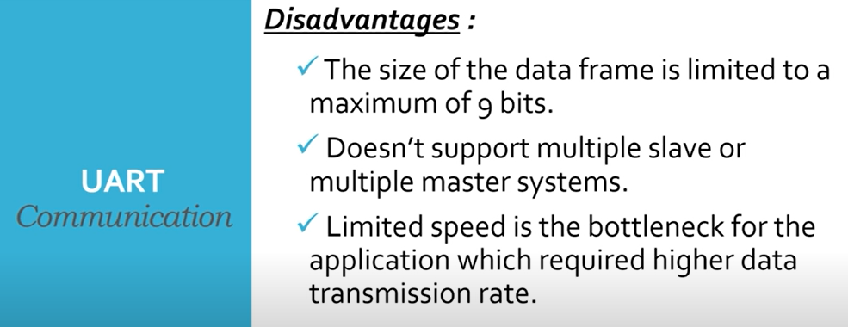

Slide 18
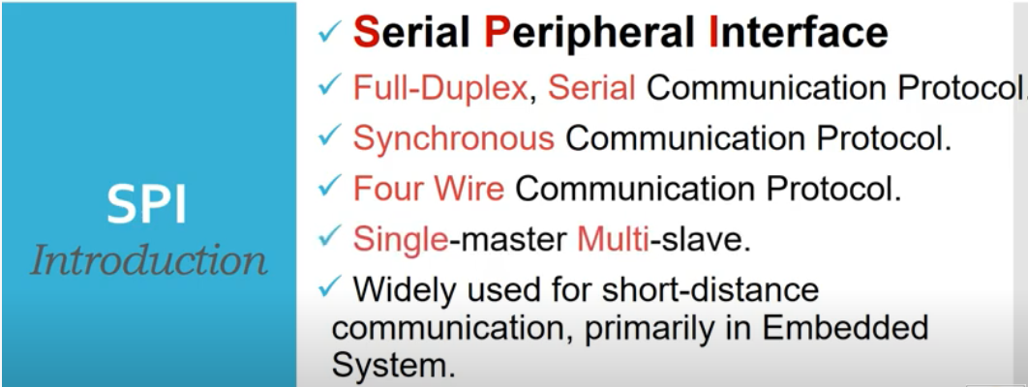

Slide 19
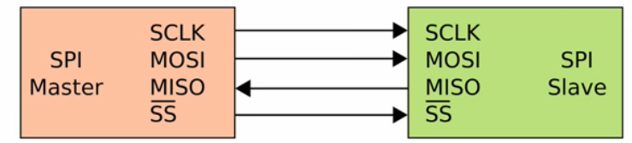
Basics of SPI

Slide 20
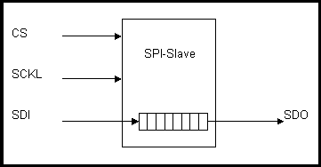
SPI Configuration
Primarily used for serial communication between a host processor and peripherals.
Can also connect 2 processors via SPI
SPI works in a master slave configuration
The master being the host microcontroller for example and the slave being the peripheral

Slide 21
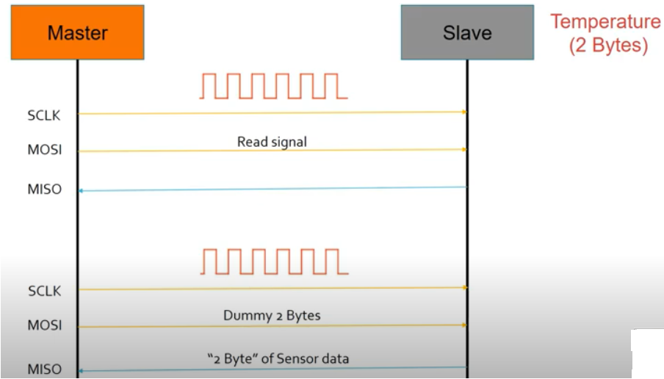
SPI example

Slide 22
SPI Operation
For SPI, there are Serial Clocks (SCLK), Chip Select lines (CS), Serial Data In (SDI) and Serial Data Out( SDO)
There is only one master, there number of slaves depends on the number of chip select lines of the master.
Synchronous operation, latch on rising or falling edge of clock, SDI on rising edge, SDO on falling edge
Operates in 1 to 2 MHz range
Master sends out clocks and chip selects. Activates the slaves it wants to communicate with

Slide 23
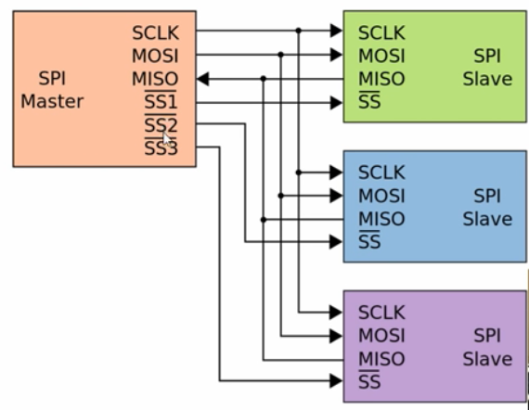
Multiple Slaves Configuration

Slide 24
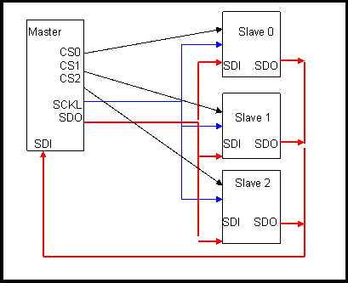
Master Slave Setup
Multiple Independent Slave Configuration

Slide 25
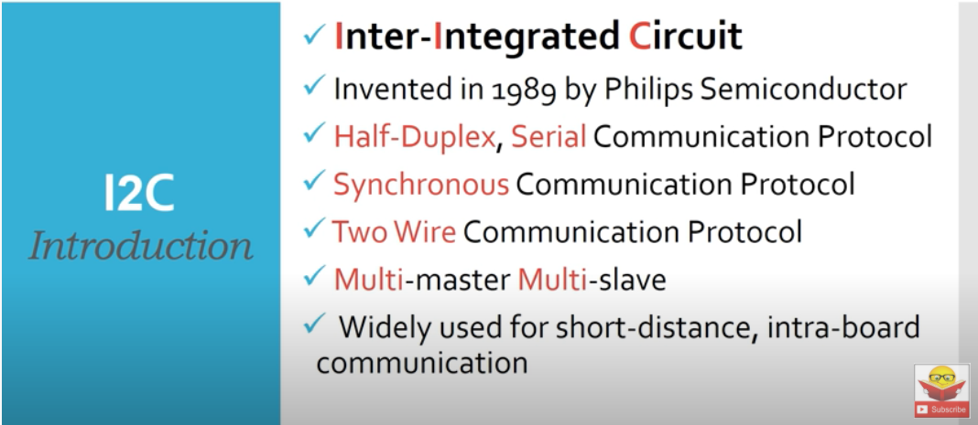

Slide 26
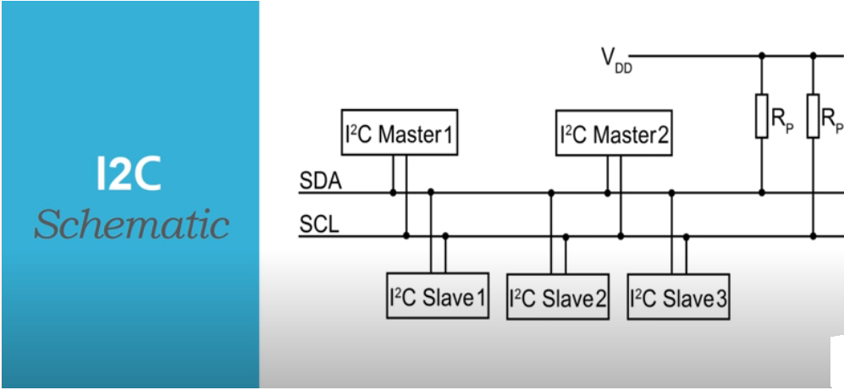

Slide 27
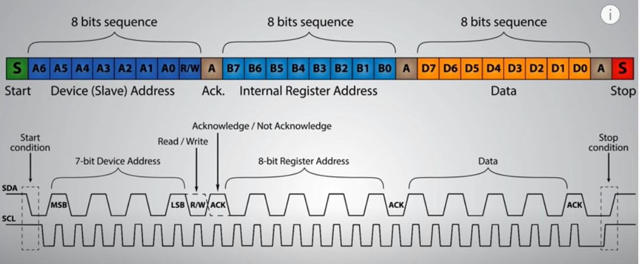

Slide 28
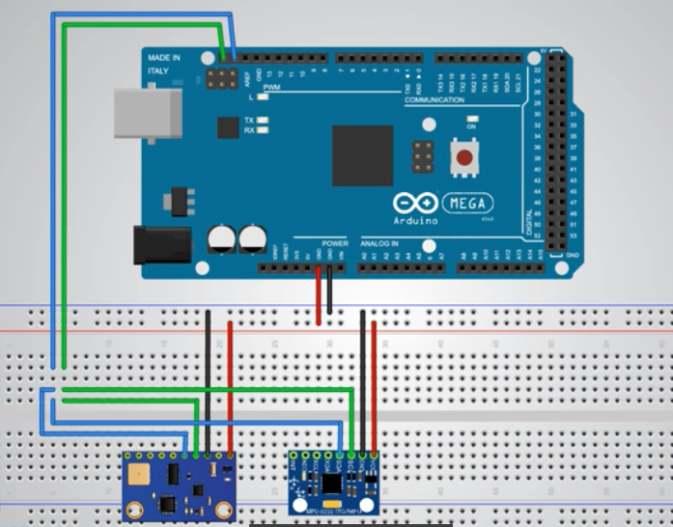
I2C example(gy-80,gy-251)

Slide 29
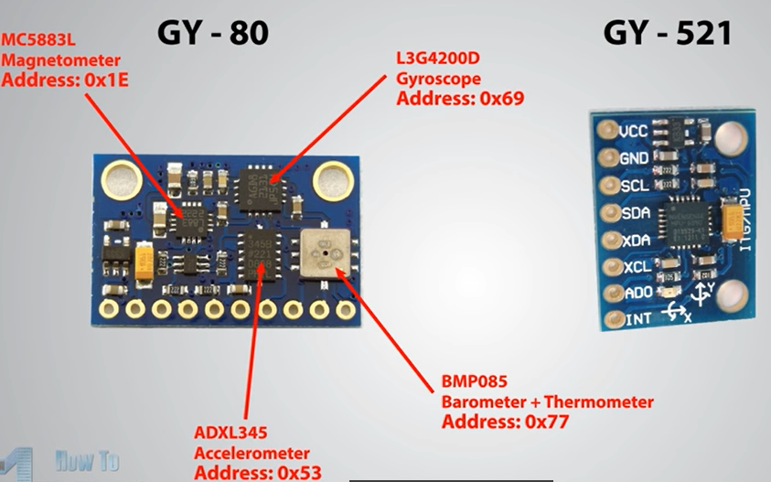

Slide 30
Microcontroller Platforms

Slide 31
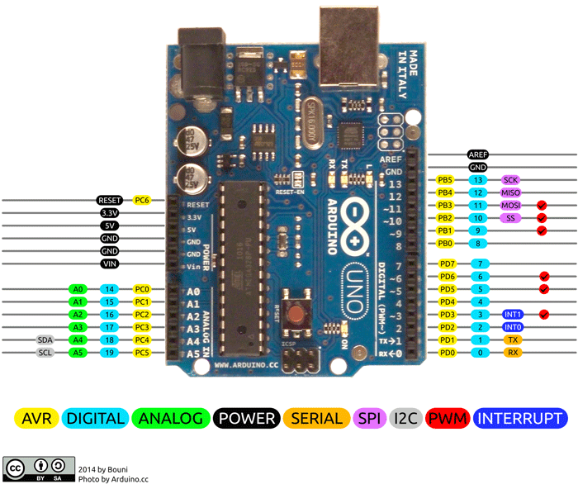
Android Uno
ATMega328 chip and uses USB, AC/DC adapter or battery as power source
supports up to 12V power using a wall-wart adapter
14 digital input/output (I/O) pins and 6 analog input pins
Six of the digital I/O pins can be used as PWM.
The analog pins’ resolution is the maximum of 10 bits , delivering 1024 different reading values
8-bit CPU, 2KB SRAM, 32 KB flash memory, 1 KB EEPROM, 16MHz clock speed

Slide 32
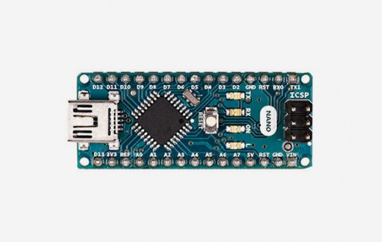
Arduino Nano
The Arduino Nano is a small, complete, and breadboard-friendly board based on the ATmega328P (Arduino Nano 3.x)
Flash Memory 32 KB of which 2 KB used by bootloader
SRAM 2 KB; Clock Speed 16 MHz
Analog IN Pins 8;EEPROM 1 KB
DC Current per I/O Pins 40 mA (I/O Pins)
Input Voltage 7-12V; Digital I/O Pins 22 (6 of which are PWM)
PWM Output 6
Power Consumption 19 mA.

Slide 33
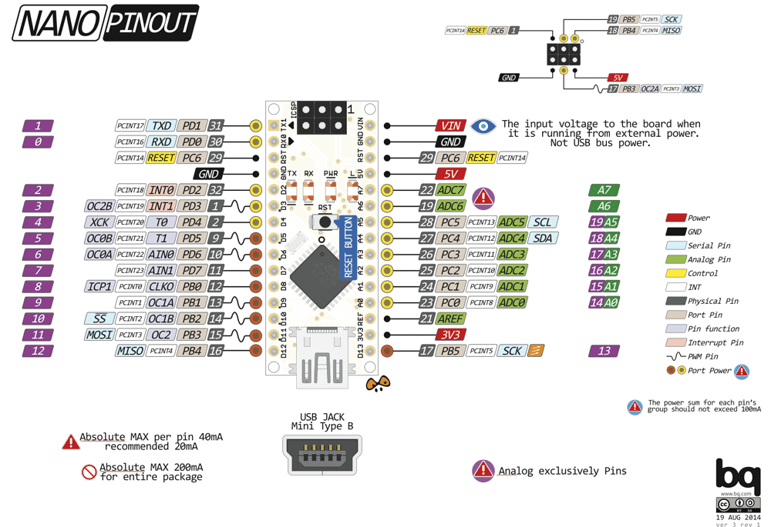
Arduino Nano Schematic

Slide 34
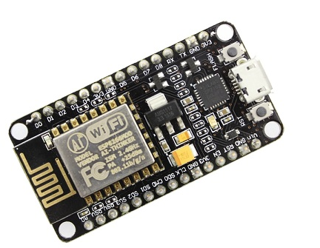
NodeMCU Platform

Slide 35
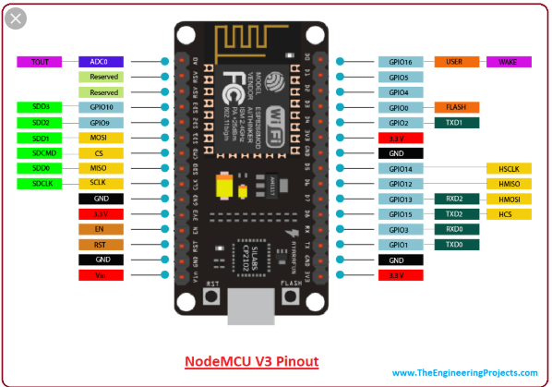
NodeMCU Platform

Slide 36
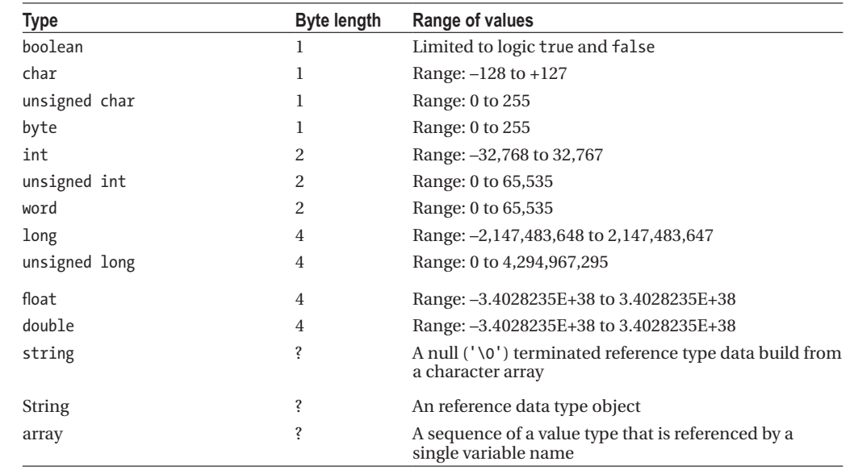
Arduino Data Types

Slide 37
Coding Fundamentals
Variables Type Variable = Value int pin = 14 pinMode(pin, OUTPUT)
int pin = 14\\Global dec void setup() {pinMode(pin, OUTPUT); }
void loop() {digitalWrite(pin, High)}

Slide 38
Cont’d
digitalWrite(pin, value)
pinMode(pin, mode)-INPUT, OUTPUT
Serial.print(78, BIN) gives "1001110"
Serial.print(78, OCT) gives "116"
Serial.print(78, DEC) gives "78"
Serial.print(78, HEX) gives "4E"
Serial.println(1.23456, 0) gives "1"
Serial.println(1.23456, 2) gives "1.23"
Serial.println(1.23456, 4) gives "1.2346

Slide 39
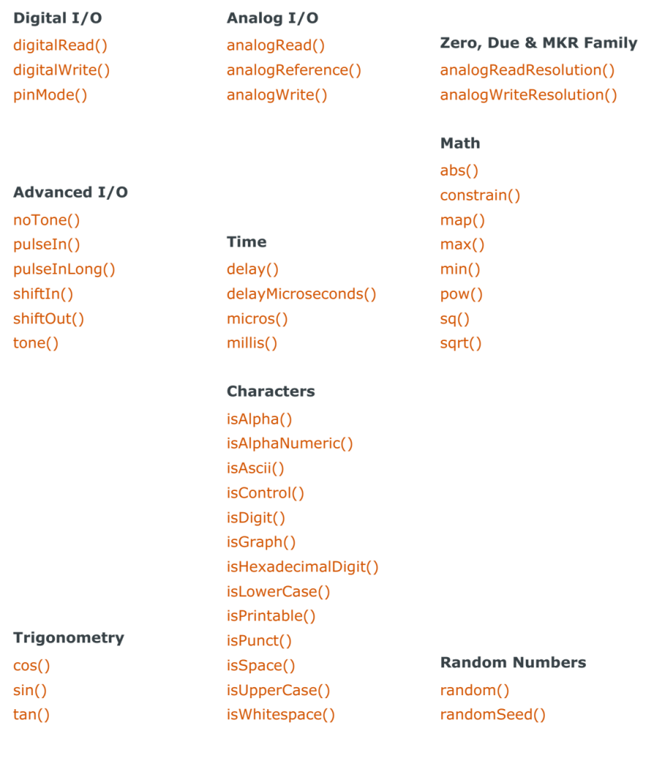
Function Reference

Slide 40
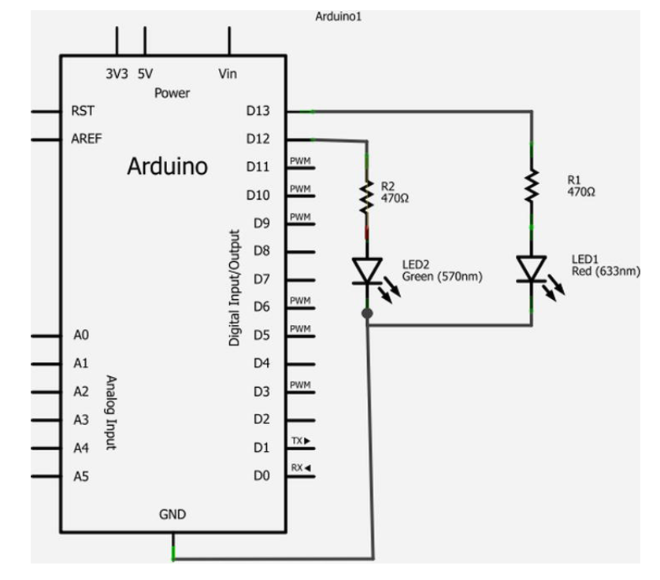
Blinking Circuit

Slide 41
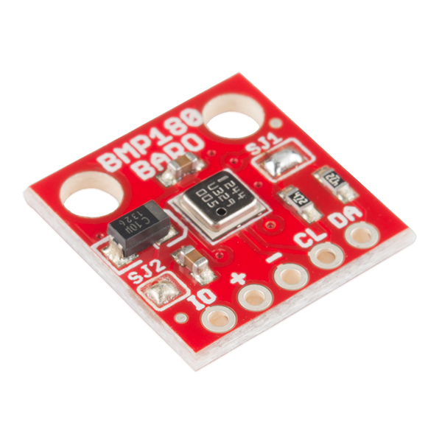
SparkFun Barometric Pressure Sensor Breakout - BMP180
This is a breakout board for the Bosch BMP180 high-precision, low-power digital barometer.
BMP180 offers a pressure measuring range of 300 to 1100 hPa with an accuracy down to 0.02 hPa
piezo-resistive technology for high accuracy, ruggedness and long term stability
It connects to a microcontroller via I²C bus (also known as TWI, or on the Arduino, the "Wire" library).

Slide 42
Cont’d
BMP180 measures absolute pressure. Since absolute pressure varies with altitude, you can use the pressure to determine your altitude.
The BMP180 measures both pressure and temperature, because temperature changes the density of gasses like air. At higher temperatures, air is not as dense and heavy, so it applies less pressure on the sensor. At lower temperatures, air is more dense and weighs more, so it exerts more pressure on the sensor
The SI unit - the Pascal (Pa). One Pascal is defined as one Newton of force per square meter. The BMP180 outputs pressure readings in Pascals, but they are converted to hectoPascals (hPa) by the software library .

Slide 43
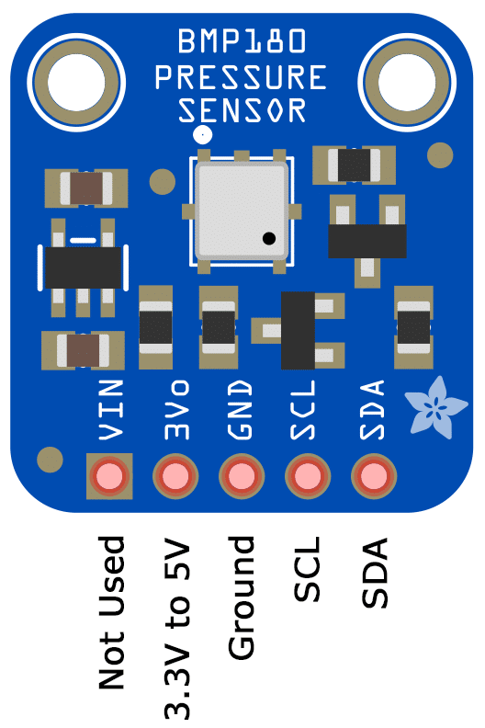
Reading pressure
SFE_BMP180 Library
startTemperature() and getTemperature()
startPressure() and getPressure()

Slide 44
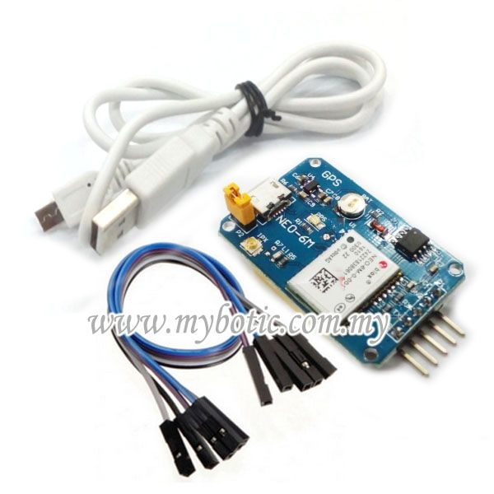
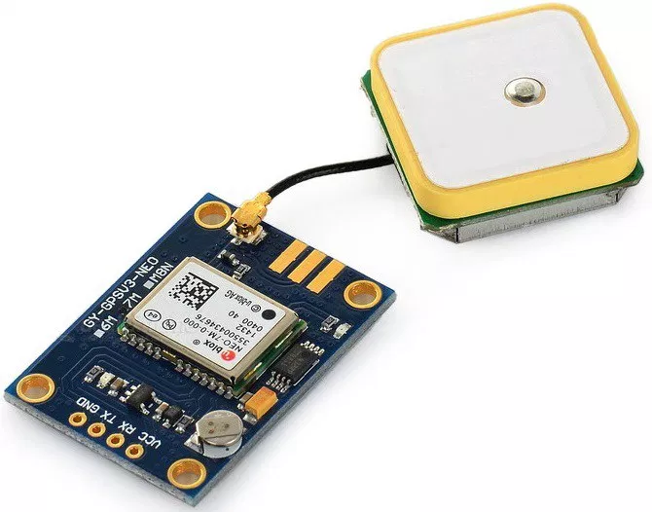
Neo-6M GPS to Arduino

Slide 45
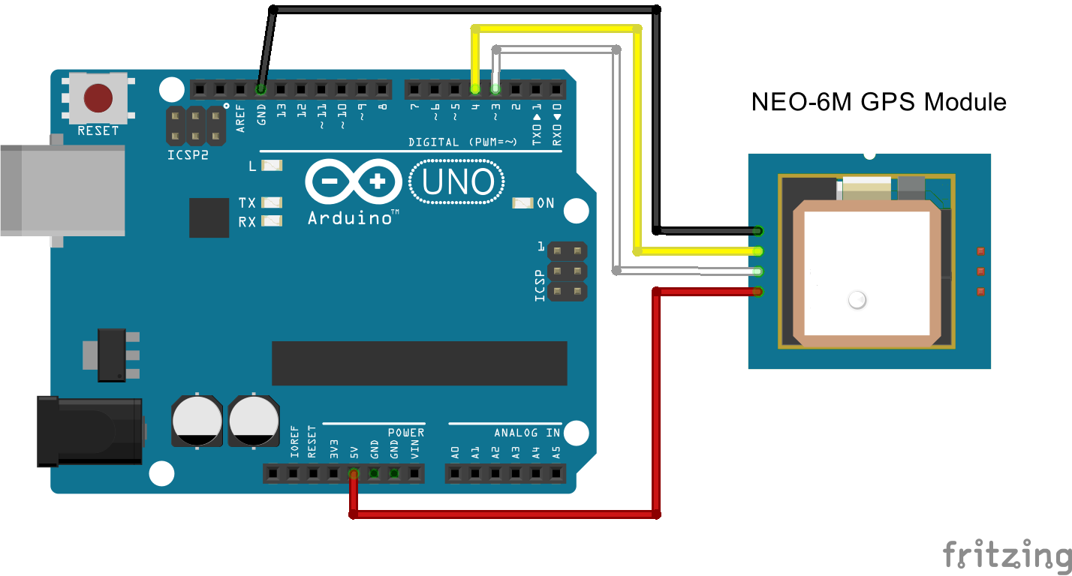
NEO-6M GPS Module

Slide 46
Libraries
SoftwareSerial is a library of Arduino which enables serial data communication through other digital pins of Arduino.
The library replicates hardware functions and handles the task of serial communication.
TinyGPS is a library that converts all those NMEA messages into a readable format by stuffing the character sequences into variables.

Slide 47
DS18B20 Water Proof temperature sensor
DS18B20 is 1-Wire digital temperature sensor from Maxim IC. Reports degrees in Celsius with 9 to 12-bit precision, from -55 to 125 (+/-0.5). Each sensor has a unique 64-Bit Serial number etched into it - allows for a huge number of sensors to be used on one data bus.
Unique 1-Wire® interface requires only one port pin for communication
Each device has a unique 64-bit serial code stored in an onboard ROM
Multidrop capability simplifies distributed temperature sensing applications
Requires no external components
Can be powered from data line.
Power supply range is 3.0V to 5.5V
Measures temperatures from –55°C to +125°C (–67°F to +257°F)±0.5°C accuracy from –10°C to +85°C
Thermometer resolution is user-selectable from 9 to 12 bits
Converts temperature to 12-bit digital word in 750ms (max.)
User-definable nonvolatile (NV) alarm settings
Alarm search command identifies and addresses devices whose temperature is outside of programmed limits (temperature alarm condition)
Applications include thermostatic controls, industrial systems, consumer products, thermometers, or any thermally sensitive system

Slide 48
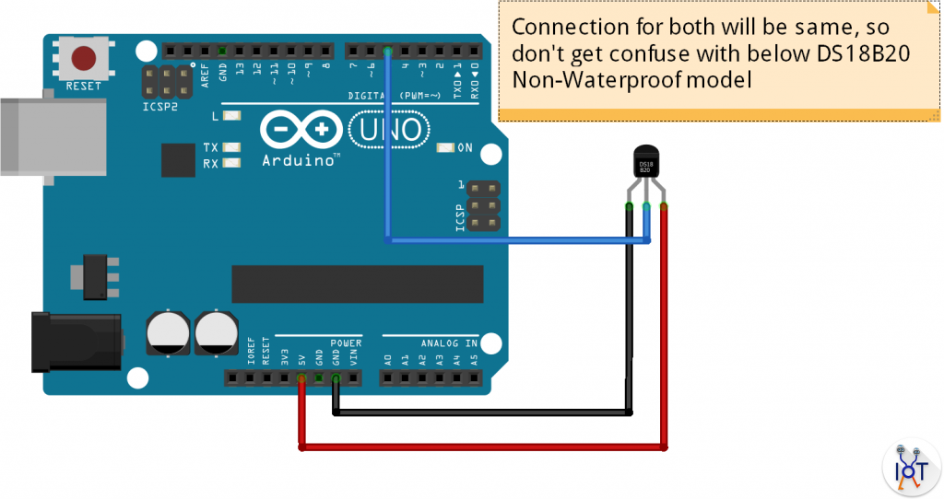
Connection
You will need a pull-up resistor of about 5 KOhm between the 1-Wire data line and your 5V power.

Slide 49
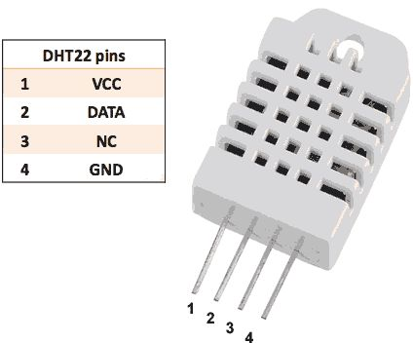
DHT22 digital temperature and humidity sensor module
the DHT-22 is a digital humidity and temperature sensor. It uses a capacitive humidity sensor and a thermistor to measure the surrounding air, and spits out a digital signal on the data pin.
Power: 3-5V
Max Current: 2.5mA
Humidity: 0-100%, 2-5% accuracy
Temperature: -40 to 80°C, ±0.5°C accuracy
No more than 0.5 Hz sampling rate (once every 2 seconds)
Body size 15.1mm x 25mm x 7.7mm
4 pins with 0.1" spacing

Slide 50
Library
https://github.com/adafruit/DHT-sensor-library

Slide 51
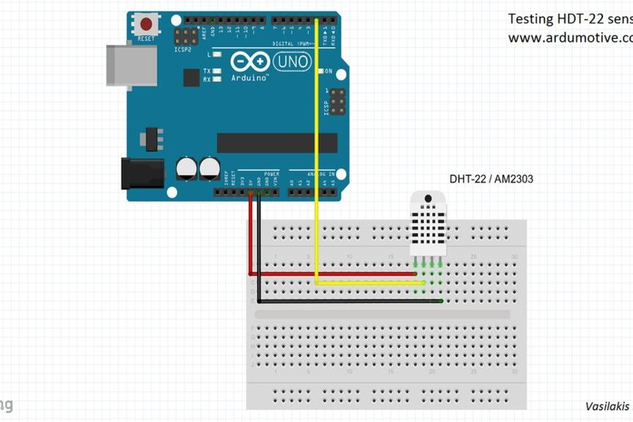
Connection

Slide 52
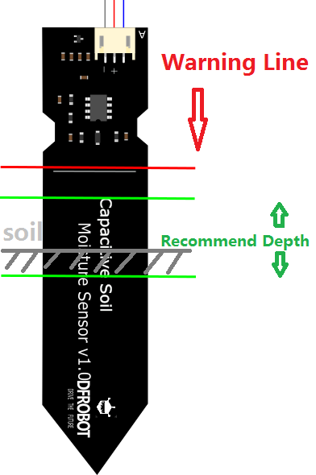
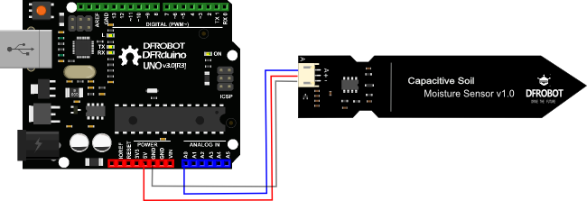
Capacitive Soil Moisture Sensor

Slide 53
Raspberry Pi

Slide 54
Raspberry Pi 2 Model B
It is actually a small computer, it runs Linux as operating system
It has a full network system, solving thus the processing problem of the Arduino.

Slide 55
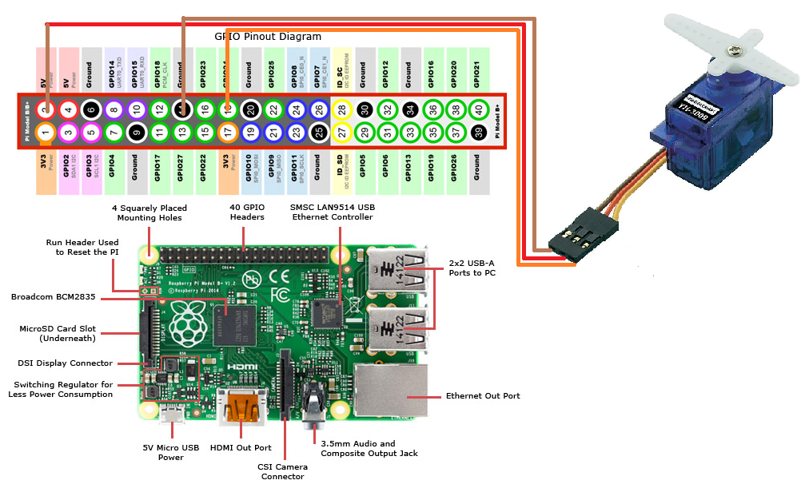
Raspberry Pi 2 Model B Pin out

Slide 56
Raspberry pi peripherals

Slide 57
Raspberry pi peripherals

Slide 58
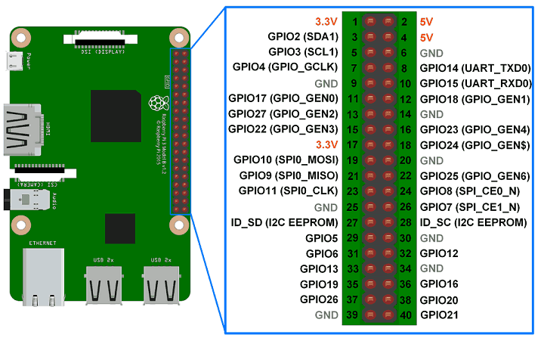
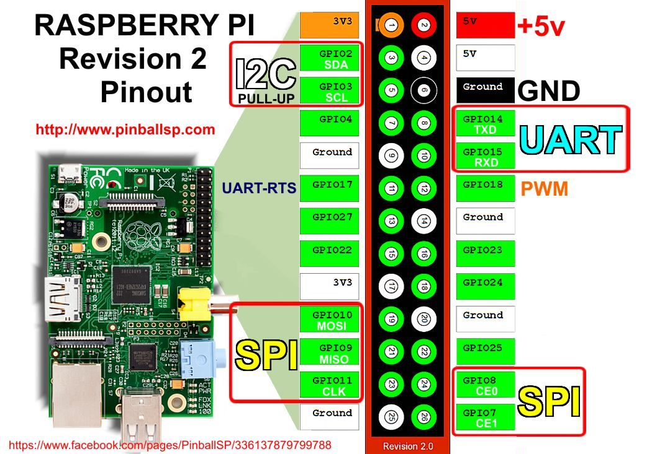
Pin out with MUX

Slide 59
Raspberry pi Models

Slide 60
Arduino & Raspberry pi

Slide 61
Thank You!!!

